Slide 1
LESSON THIRTEEN
TOPICS: HOW TO ADD AN END-OF-GAME SPLASH SCREEN.

Slide 2
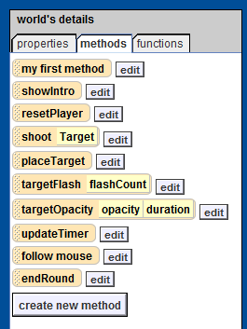
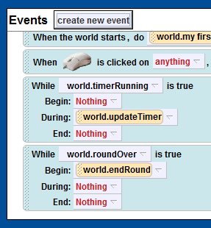
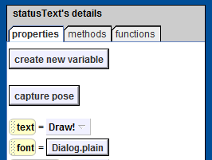
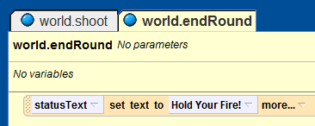
Step 1: Setting Up a Method to End the Game
Create a new method for the world object called “endRound”.
Create a new “while something is true” event.
Set the condition for your new event to the variable “world.roundOver.”
Set the “begin” method for your new event to “world.endRound.”
Drag the “statusText.text” property from the statusText object into the “world.endRound” method and set it to “Hold Your Fire!”.

Slide 3
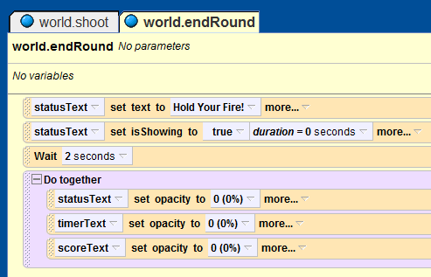
Step 2: Set the End Game Text Opacities
Drag the “statusText.isShowing” variable into the “world.endRound” method and set its value to true with duration of “0”.
Add a “wait 2 seconds” statement to the endRound function.
After the wait statement, add a “do together” block.
Inside the do together block, add the following three lines:
statusText.opacity = “0”
timerText.opacity = “0”
scoreText.opacity = “0”

Slide 4
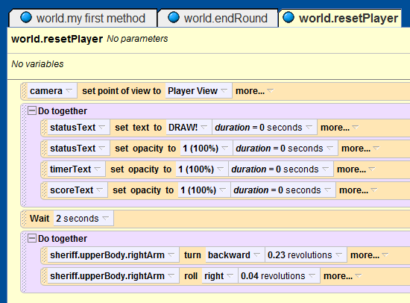
Step 3: Update the resetPlayer Method
Add a new “do together” block after the
Line in the “world.resetPlayer” method.
Inside the new do together block, add the following four lines
statusText.text = “DRAW!” with duration “0”
statusText.opaicty = “1” with duration “0”
timerText.opacity = “1” with duration “0”
scoreText.opacity = “1” with duration “0”

Slide 5
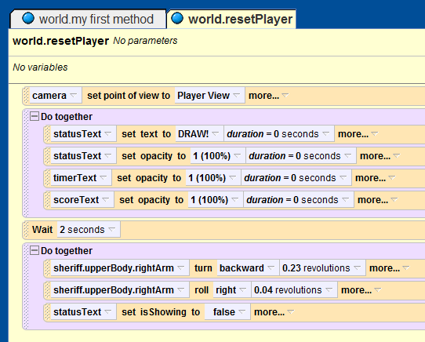
Step 4: Finish Updating the resetPlayer Method
In the second do together block in the “world.resetPlayer” method, add the following line:
statusText.isShowing = “false”

Slide 6
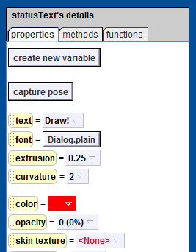
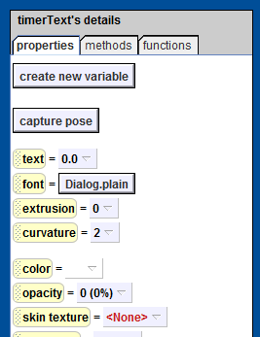
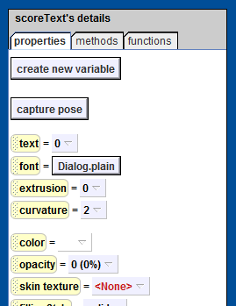
Step 5: Set the Initial Opacity for the Text Objects to Zero
Find the statusText, timerText, and scoreText objects, and set their opacity to zero.

Slide 7
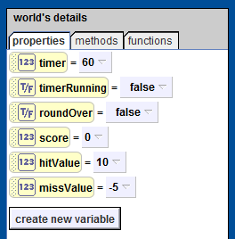
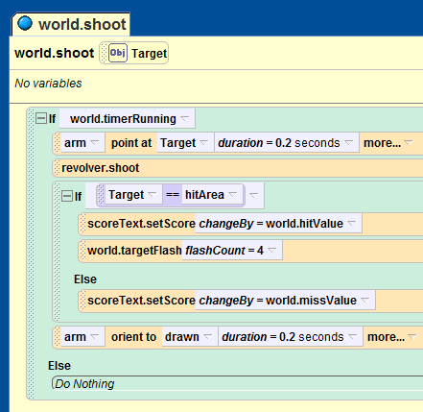
Step 6: How to Keep Score
Add two new number variables, “hitValue” and “missValue”, to the world object.
Set world.hitValue = “10”, and
World.missValue = “-5”
Before the line
in the “world.shoot” method, add a call to “scoreText.setScore” with the input set to “world.hitValue.”
In the “else” clause for the same conditional, add another call to “scoreText.setScore”, but with the input set to “world.missValue.”

Slide 8
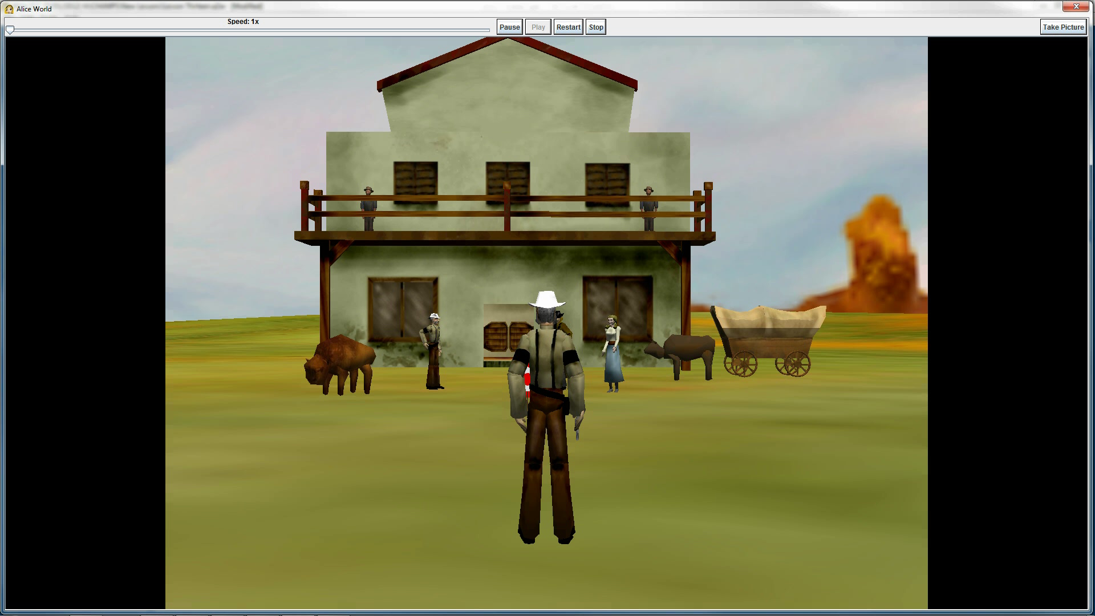
Final Scene

